Slide 1


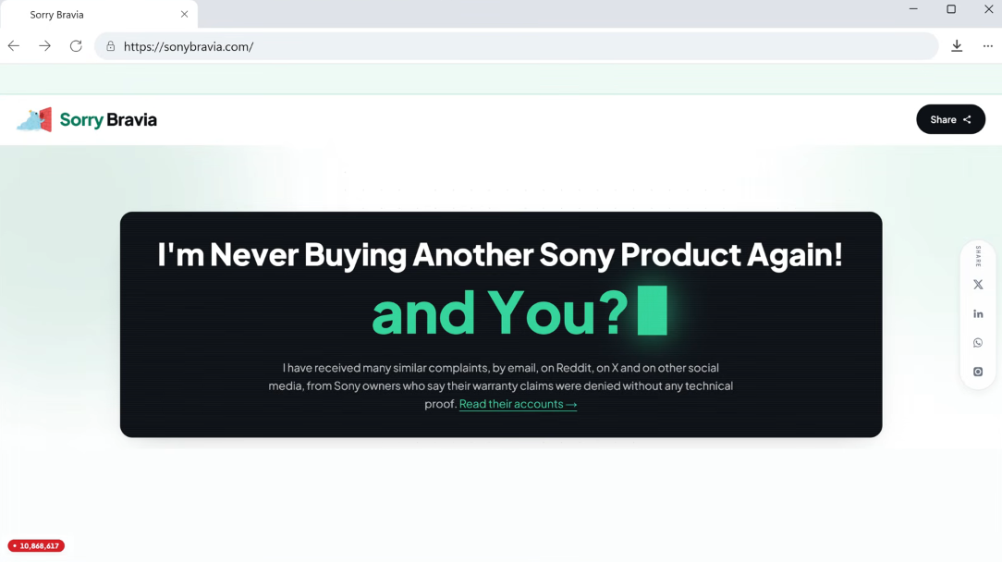

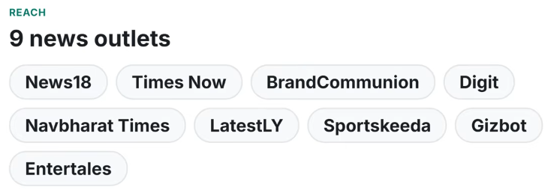
Sorry Bravia
Google Antigravity Tutorial for Beginners:
Design and Build a Web App Free

Slide 2
Before continue
Edit the content
Use your own title / name
Use your own theme – change the color

Slide 3
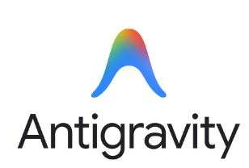



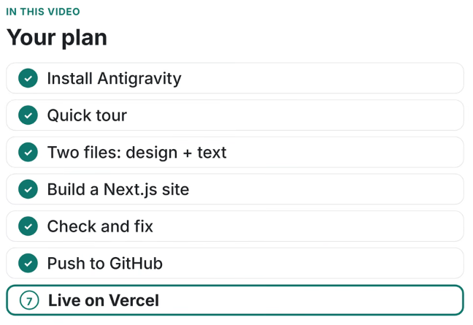
Step-by-step tutorial on how to build and deploy a free, professional Next.js website using Google Anti-gravity and two simple files (DESIGN.md and your text content), without writing any code.
Here is a quick summary of the 7 core steps covered:
Install Anti-gravity: Download and install Google's AI app from anti-gravity.google/download and sign in with your Google account.
Quick Tour: Familiarize yourself with the interface, models (like Gemini 3.8 Flash), and permission modes.
Prepare Two Files: Get a design file from designmd.ai (e.g., the "sorry Bravia" consumer case file) and place it alongside your text content file in an empty folder.
Build the Web App: Open the folder in Anti-gravity and prompt the agent to create a Next.js landing page following your design and text files exactly.
Check and Fix: Review the generated site against your text, spot-check for any unrequested AI additions, and give simple plain-English prompts to fix layouts or spacing.
Push to GitHub: Create an empty public GitHub repository, have Anti-gravity add a .gitignore file, and commit/push your code.
Put it Live on Vercel: Import your GitHub repository into Vercel, deploy with automatic Next.js settings, and publish your site for free on the hobby plan.

Slide 4
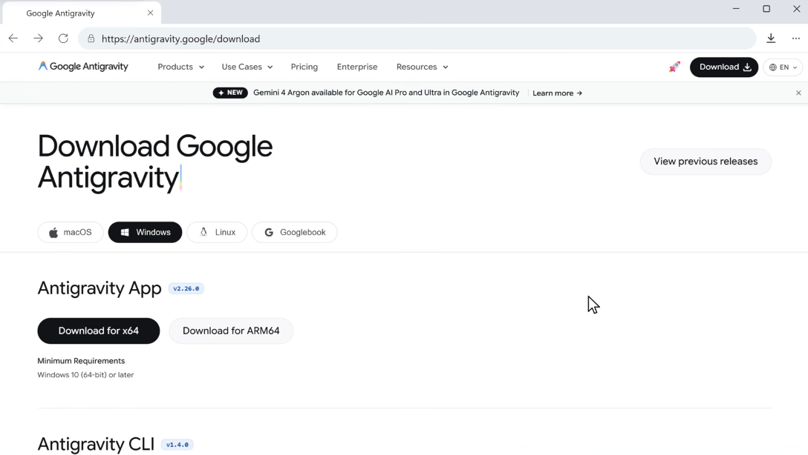

Slide 5
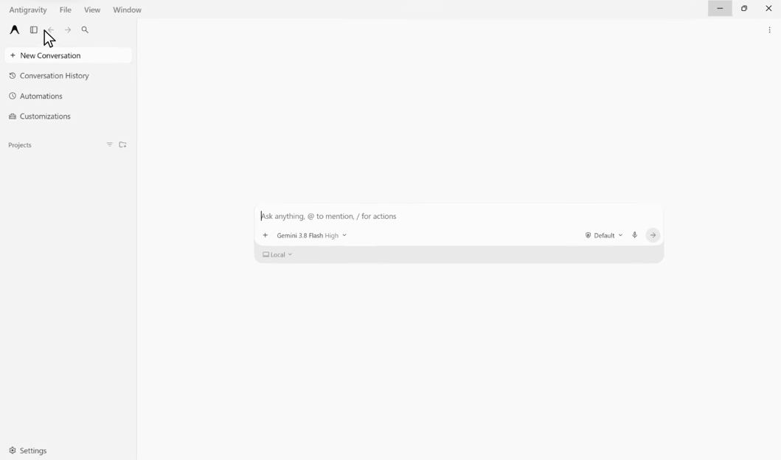



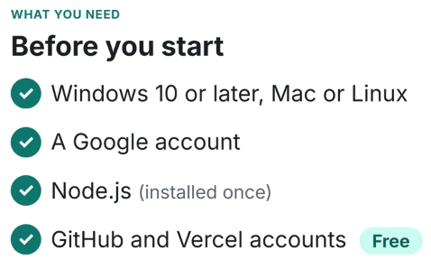

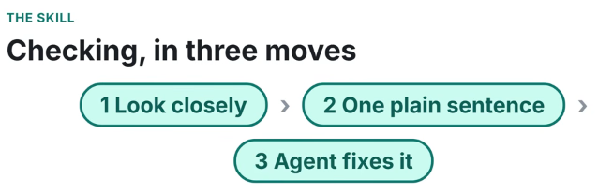

Slide 6
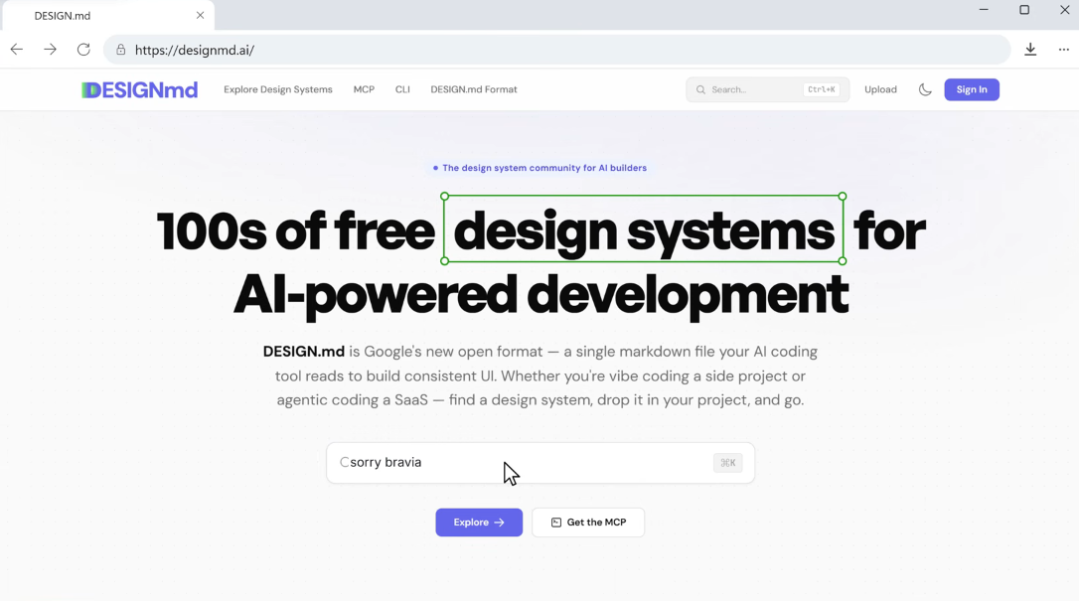
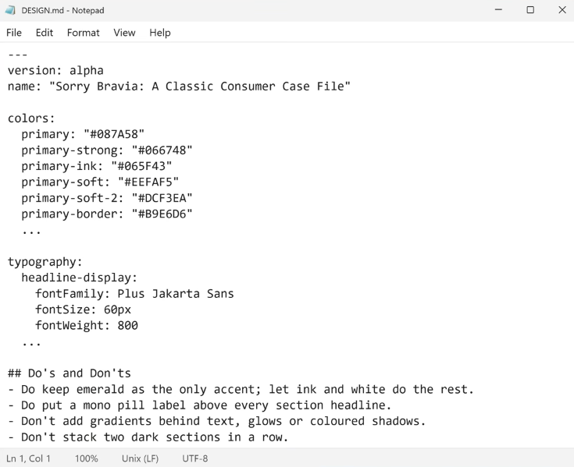
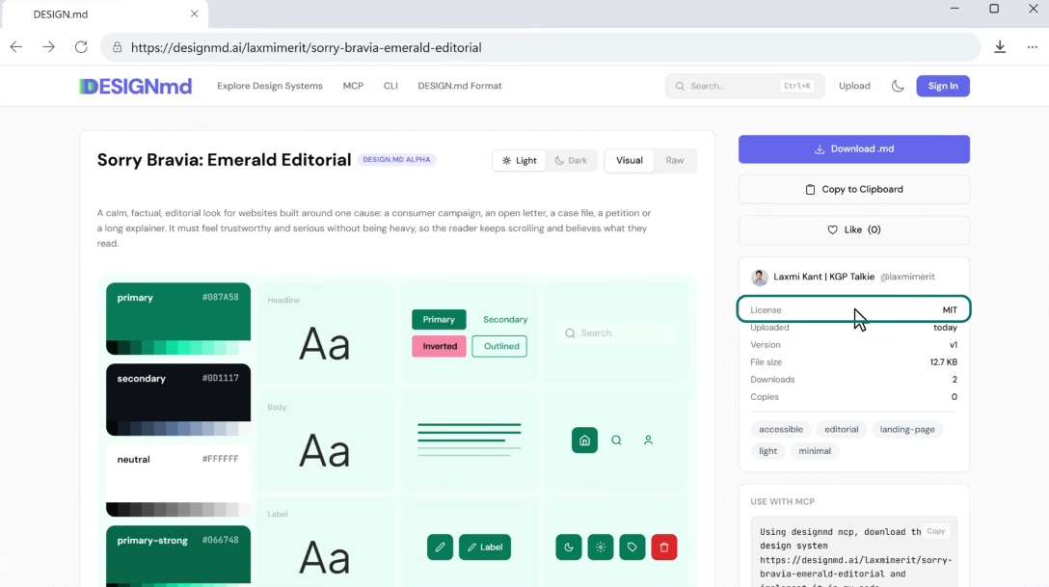

Slide 7
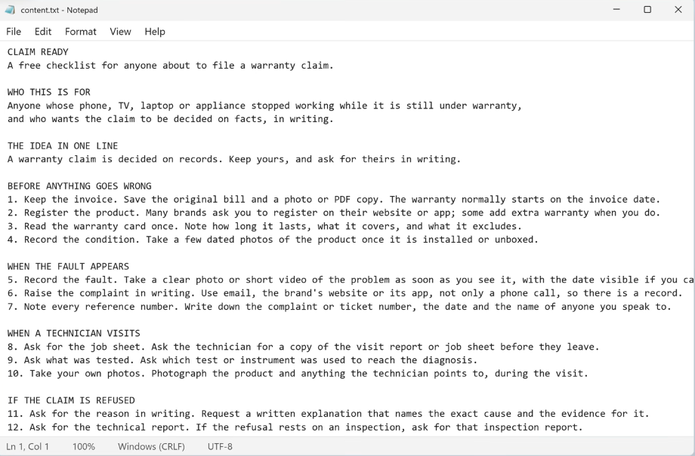
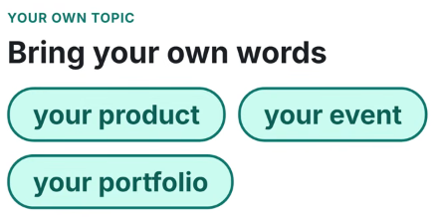
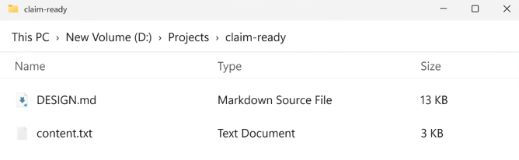

Slide 8
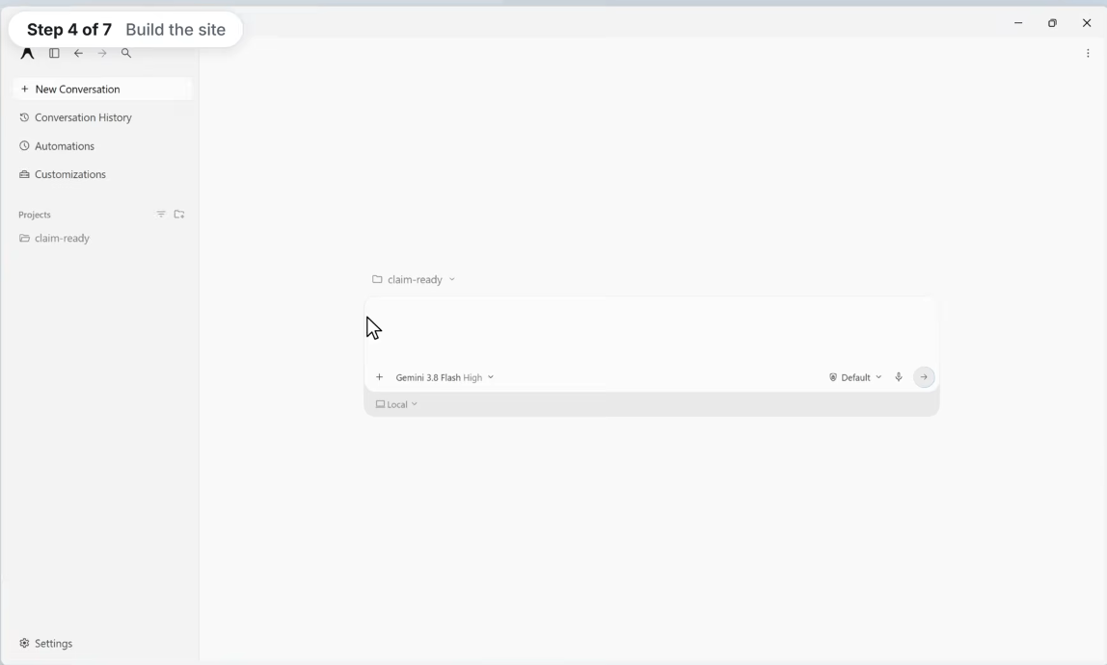
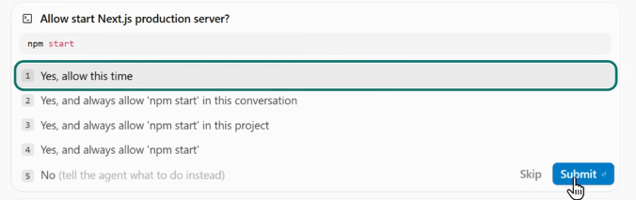

Slide 9
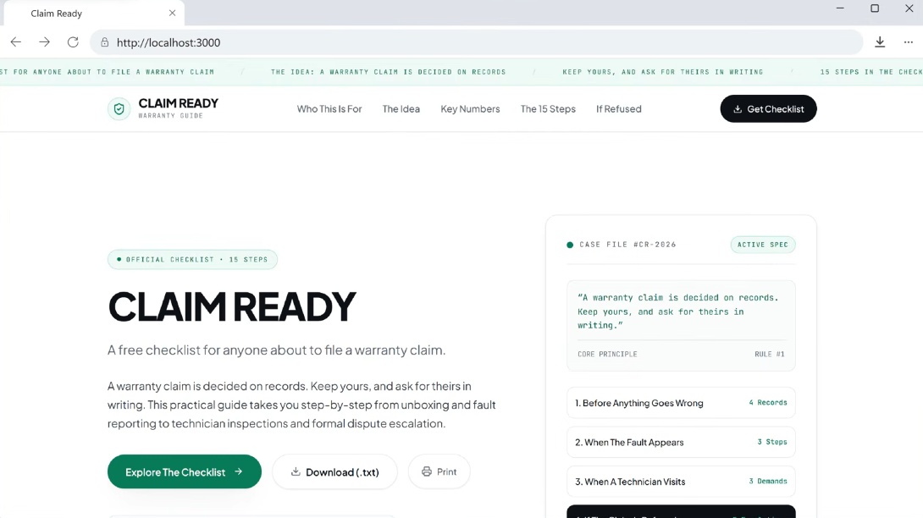
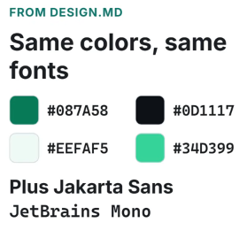


Slide 10
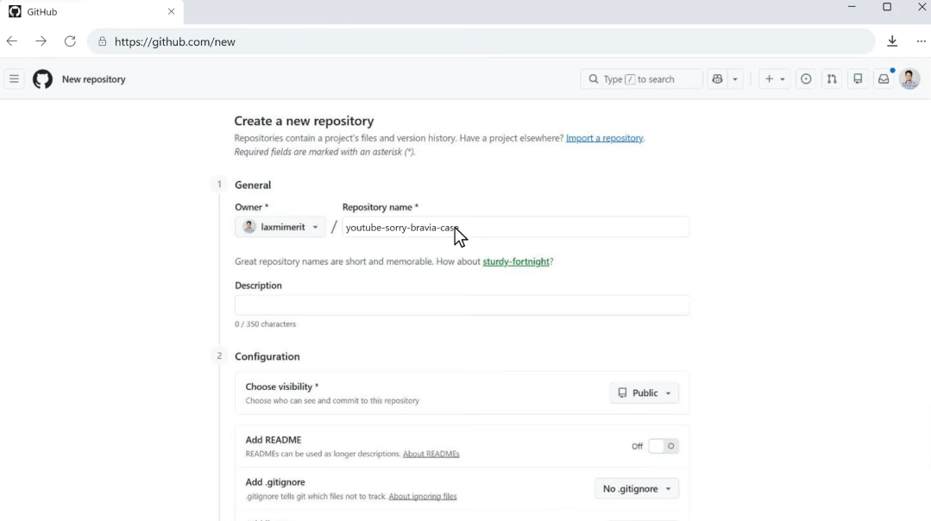
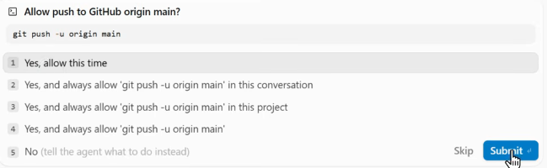

Slide 11
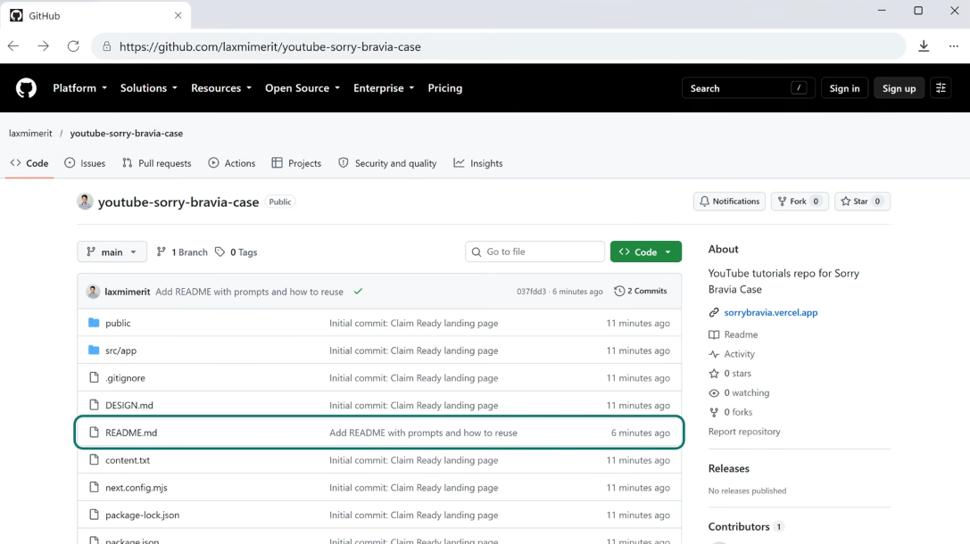


Slide 12

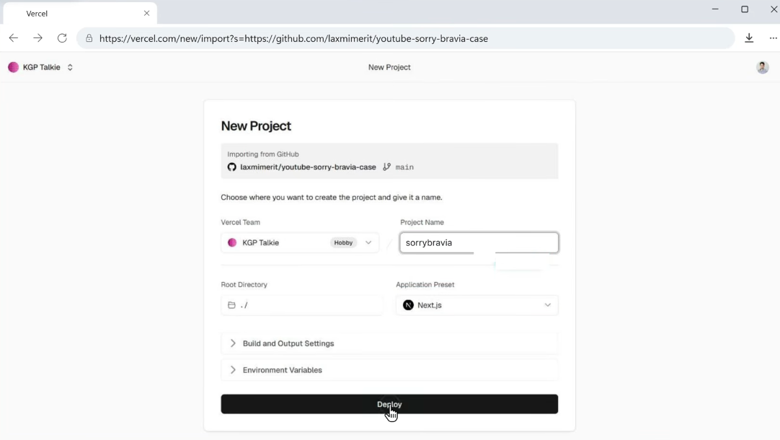


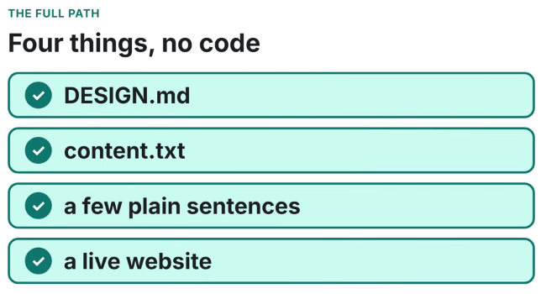

Slide 13
WHAT TO SUBMIT IN B
JPG snapshots of
Antigravity
Github
Vercel
Live – browser, with the URL

Slide 14
References
Chapters
0:00 A free website, start to finish
0:26 Why this design
1:03 What Google Antigravity is
1:25 What you need
1:43 Step 1: Install Antigravity
2:17 Step 2: Quick tour
3:18 Step 3: Two files (DESIGN.md + your text)
4:32 Step 4: Build the web app
6:13 Step 5: Check and fix
7:19 Step 6: Push to GitHub
8:02 Step 7: Live on Vercel
8:39 Wrap-up
Design file (DESIGN.md, MIT): https://designmd.ai/laxmimerit/sorry-...
Repository with all five prompts: https://github.com/laxmimerit/youtube...
The finished site: https://sorrybravia.vercel.app
Download Antigravity: https://antigravity.google/download
Antigravity pricing: https://antigravity.google/pricing
Node.js: https://nodejs.org

Slide 15
PROMPTS
Create a Next.js app in this folder and build one landing page from the text in content.txt. Follow DESIGN.md exactly for the colors, fonts, spacing and components. Use every section of content.txt and keep its wording. Make it work on phones too. When it is done, run it locally so I can preview it.
===================
The page has text that is not in content.txt, like "Official checklist", the extra tip under every step, and lines such as "Brands cannot legally withhold the technical assessment report". Remove every sentence, label and tip that is not in content.txt, so the page only says what content.txt says. Keep the design and layout.
===================
Good, the text is right now. Three fixes: 1) KEY NUMBERS FOR THE PAGE, CALL TO ACTION and FOOTER NOTE are my notes, not page headings, so hide those three headings. 2) Keep the header on one line: the logo, two links "The 15 steps" and "Key numbers", and the Download button. 3) In "Who this is for", show the full sentence once and remove the four device cards. Keep everything else as it is.
===================
On a phone the header is too wide and the Download button is cut off on the right. On small screens, hide the two header links so the logo and the Download button fit.
===================
Add a .gitignore for Next.js, then commit everything and push it to https://github.com/laxmimerit/youtube-sorry-bravia-case on the main branch.

Slide 16
Aspect | Node.js | Next.js
What is it? | JavaScript runtime | React web framework
Main purpose | Run JavaScript outside browser | Build complete web applications
Frontend | ❌ Not by itself | ✅ React
Backend/API | ✅ Excellent | ✅ Built-in API/Route Handlers
React required? | ❌ | ✅
Routing | Need framework/library | ✅ Built-in
SSR (Server-Side Rendering) | ❌ Not by itself | ✅
Static generation | ❌ | ✅
Full-stack app | Possible, but need more libraries | ✅ Designed for it
Deployment | Many options | Vercel, Cloud Run, etc.
Typical use | Backend, API, servers, CLI | Modern web applications

Slide 17
Platform | GitHub → Cloud | Frontend | Backend/API | Docker | Serverless | Best for
Vercel | ✅ | ⭐⭐⭐ | ✅ | Limited | ✅ | Next.js / React
Netlify | ✅ | ⭐⭐⭐ | ✅ | Limited | ✅ | Frontend/web apps
Render | ✅ | ✅ | ⭐⭐⭐ | ✅ | ✅ | Full-stack apps
Railway | ✅ | ✅ | ⭐⭐⭐ | ✅ | ✅ | Easy backend/full-stack
Heroku | ✅ | ✅ | ⭐⭐⭐ | ✅ | ✅ | Traditional web apps
Google Cloud Run | ✅ | ✅ | ⭐⭐⭐ | ⭐⭐⭐ | ✅ | GCP applications
Google App Engine | ✅ | ✅ | ⭐⭐⭐ | Limited | ✅ | Managed web applications
GKE | ✅ | ✅ | ⭐⭐⭐ | ⭐⭐⭐ | ❌ | Kubernetes

Slide 18
Lab: Build a Web Application with Google Antigravity and Deploy it from GitHub to Google Cloud Run
Students do:
Step 1: Use Antigravity to generate a web application
Step 2: Test locally
Step 3: Create GitHub repository
Step 4: Push application to GitHub
Step 5: Connect GitHub to Cloud Run
Step 6: Deploy
Step 7: Modify code in Antigravity
Step 8: git push
Step 9: Cloud Run automatically redeploys
Step 10: Test the new version
This gives students a very clear demonstration of AI-assisted development + Git + CI/CD + serverless cloud deployment.
https://docs.cloud.google.com/run/docs/quickstarts/deploy-continuously

